Slide 1
RICE algorithm for sensor data CODEC
Data COmpression & DECompression

Slide 2
Scope of the presentation
Requirement for compression
Methodology of prototype implementation
Brief introduction of RICE algorithm
Implementation details and results
Next deliverable
Hardware implementation

Slide 3
Requirement for compression
To reduce the data size of the telemetry system
The high sampling rate sensor and other telemetry data (depends on the monitoring requirement) are contributing to the major portion of the telemetry data size
Hence with the compression of data in those lines the telemetry data size is expected reduce by one by fourth (minimum).
Engine computer
Data
Compression
Telemetry computer
Flight computer

Slide 4
Methodology of prototype implementation
RICE algorithm has been suggested in Consultative Committee for Space Data Systems (CCSDS) blue book and green book for lossless compression of 1D data.
The RICE algorithm has been implemented in python
The algorithm has been tested with the real time test data
The compression ratio and % error in data after compression is calculated (if any)
Methods to improve the compression ratio has been presented

Slide 5
RICE Algorithm
The Rice coding algorithm offers several advantages when used for data compression:
1. Efficient for small integer values: Rice coding excels at compressing data with small integer values that are frequently encountered in sensor data. This results in significant reductions in data size while maintaining high accuracy.
2. Lossless compression: Rice coding is a lossless compression method, meaning it preserves the original data without any loss of information. This is crucial in applications where data integrity is paramount.
3. Variable-length coding: The algorithm uses variable-length codes, which means that common small values are assigned shorter codes, reducing the overall data size. This is especially advantageous for datasets with varying value distributions.
4. Simple and fast encoding and decoding: Rice coding is relatively straightforward to implement and is computationally efficient. This makes it suitable for real-time applications where speed is important.
5. Well-suited for certain data types: It is particularly effective for sensor data with a skewed distribution of values, where a few values occur much more frequently than others.
6. Used in space and satellite communications: The Consultative Committee for Space Data Systems (CCSDS) recommends Rice coding for space applications due to its efficiency in reducing the amount of data transmitted and stored, which is critical in space missions.
8. Suitable for low bandwidth or resource-constrained environments: Rice coding can be an excellent choice when dealing with limited bandwidth or resource-constrained systems, as it helps to reduce the data size without compromising data quality.
The Rice coding algorithm, recommended by the Consultative Committee for Space Data Systems (CCSDS), is a widely-used method for lossless data compression, particularly in the context of sensor data transmission and storage. It is designed to efficiently encode integer values with a focus on small values that occur frequently in sensor data streams. The core idea behind Rice coding is to represent data using variable-length codes, where shorter codes are assigned to smaller integers and longer codes to larger ones, enabling more efficient storage and transmission of data. This algorithm is particularly valuable in applications where preserving data accuracy and reducing data size are essential, such as in space exploration and satellite communications.
AgniKul Cosmos Private Limited - Private & Confidential

Slide 6
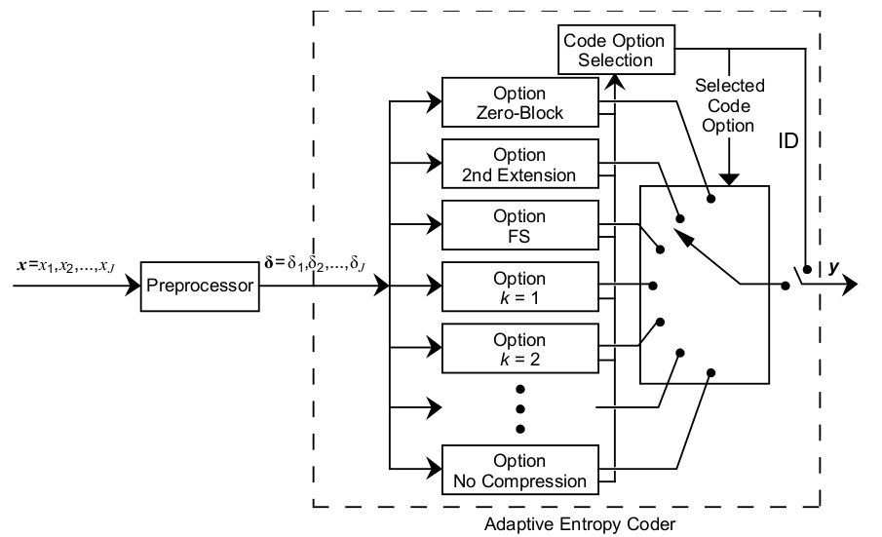
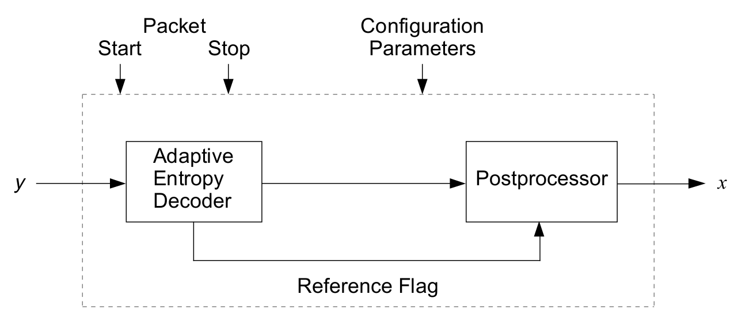
Structure
CODER: Consists of a Pre-Processor & Adaptive Entropy-Encoder
DECODER: Consists of a Adaptive Entropy-Decoder & Post-Processor

Slide 7
Working Principle
Break Sequence into blocks of block-size by combining blocksize number of samples
Pre-Processes each block
Feed the o/p to adaptive entropy decoder
Each entropy encoder tries to reduce the number of total bits in a block
Choose the algorithm that minimizes the encoded sequence length
Format the block & send
Resolution: number of bits to express a number
Block Size: Number of samples in one block
Entropy: Measure of randomness
H = -p . log(p)
Compression Ratio:
Original Sequence length / Compressed sequence length
AgniKul Cosmos Private Limited - Private & Confidential

Slide 8
Entropy Coding
Entropy Coding
Fundamental Sequence (FS) block
Split Sample
No Compression
Zero Block
Second Extension
The algorithm option that yields the shortest encoded length for the current block of data is selected for transmission
Requirements
Block Size = 8/16/32/64
Sample Resolution = max 32 bits
Coding option ID
One code options is used to represent an incoming block of preprocessed data samples.
A unique identifier (ID) bit sequence is attached to the code block to indicate to the decoder which decoding option to use.
AgniKul Cosmos Private Limited - Private & Confidential

Slide 9
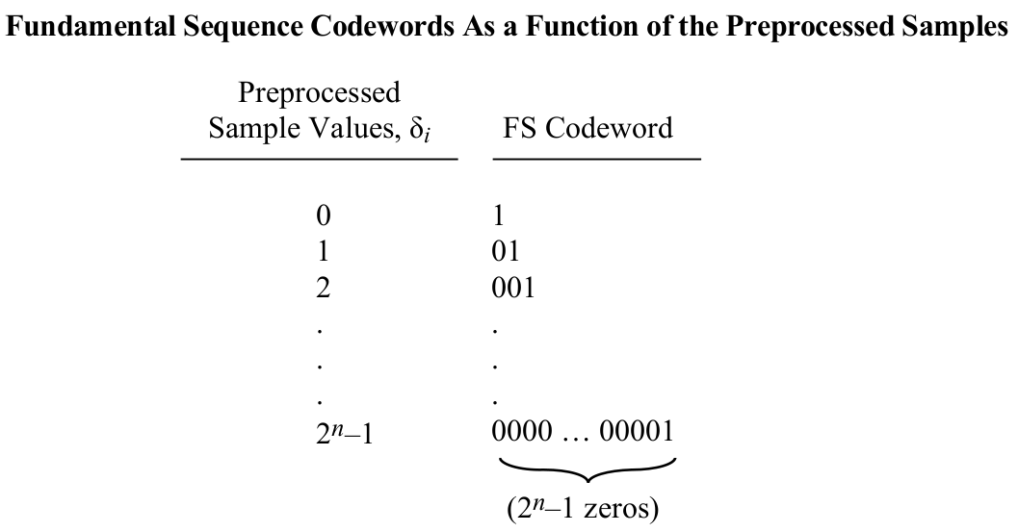
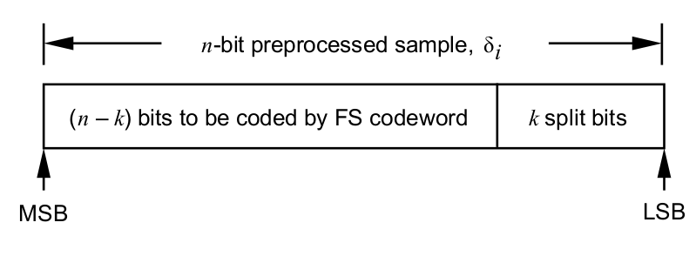
Entropy Coding (General)
FS Code
The most basic option is a variable-length FS codeword, which consists of ‘m’ zeros followed by a one when preprocessed sample δi = m
Split Sample Options
The kth split-sample option is obtained by encoding the (n−k) MSBs from the binary representation of each preprocessed sample δi with an FS codeword
No Compression
This option is to not apply any data compression. If it is the selected option, the entire preprocessed block of J samples receives an attached identification field but is otherwise unaltered.

Slide 10
Entropy Coding (Low Entropy)
Second Extension
When the Second-Extension option is selected, each pair of preprocessed samples in a J-sample block is transformed and encoded using an FS codeword. A pair of consecutive samples (δ2 j−1 , δ2 j) from a J-sample preprocessed data block are transformed into a single new symbol γj
γj = (δ2 j−1 + δ2 j)(δ2 j−1 + δ2 j + 1)/2 + δ2 j , where j = 1, 2, … J/2.
Second-Extension Option is only designed to be a useful option when all of the transformed symbols γj are small.
Zero Block
The Zero-Block option is always selected when one or more consecutive blocks of preprocessed samples are all zeros. In this case, a single CDS(Coded Data Set) represents the entire sequence of All-Zeros blocks, unlike other options in which each CDS output from the entropy coder represents only a single block.

Slide 11
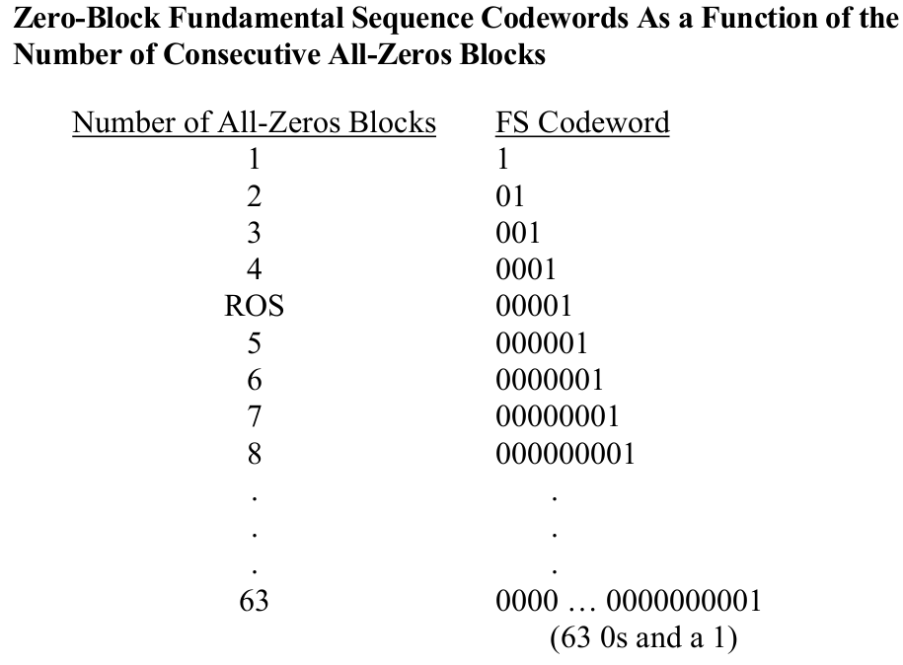
Entropy Coding (Low Entropy)

Slide 12
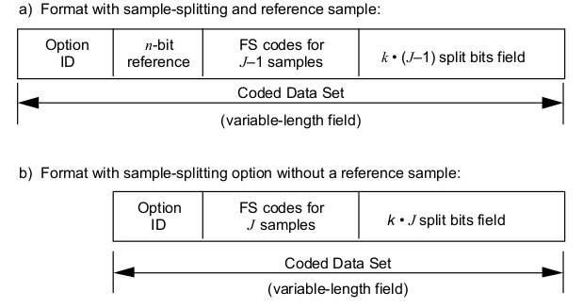
Coded Data Set (CDS) format
Split Sample

Slide 13
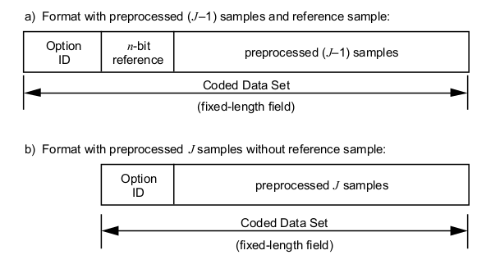
Coded Data Set (CDS) format
No compression

Slide 14
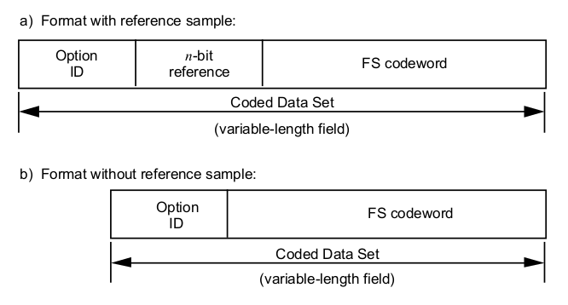
Coded Data Set (CDS) format
Zero Block

Slide 15
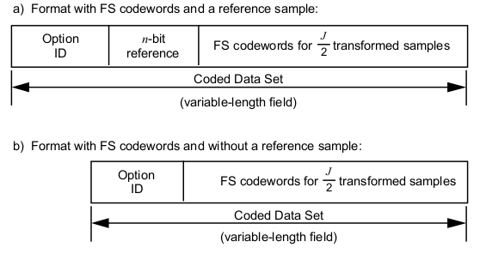
Coded Data Set (CDS) format
Second Extension

Slide 16
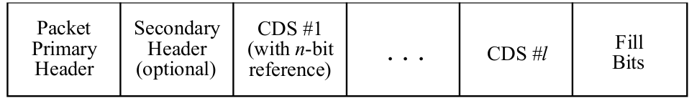
Lossless Packet Format
The CCSDS space packet structure is used to transport the CDSes.
The packet formatter uses the parameter provided by the source data coder to form one or more CDSes to determine the packet size in bytes.
Fill bits of zero value may be needed to force the packet to end on a byte boundary

Slide 17
Decoder
Depacketize: extract the variable length encoded binary sequence
ID extraction: Extract the entropy coding option ID
Entropy Decoder: Retrieve the pre processed values
Pos Processor: Reverse the preprocessor to get the original sequence
Depacketize and reverse the coding process
AgniKul Cosmos Private Limited - Private & Confidential

Slide 18
Details of sample data
Sample data: Stack Test data (Cold flow)
Size of block chosen : 64
Number of block : 100367
Total sample size : 463.1 mb

Slide 19
Results
Resolution: 16 bits
Block Size: 64 samples
Number of data fed : 6423509
Sensor 1: 4.02 | 3.98
Sensor 2: 3.86 | 3.87
Sensor 3: 1023.67 | 1023.67
Sensor 4: 4.01 | 4.07
Sensor 5: 4.08 | 4.13
Sensor 6: 4.16 | 4.09
Sensor 7: 4.06 | 4.04
Sensor 8: 2.84 | 2.8
Overall compression: [3.5 - - - 4]
The CODER & DECODER has been prototyped in python
Agnikul Cosmos Private Limited - Private & Confidential

Slide 20
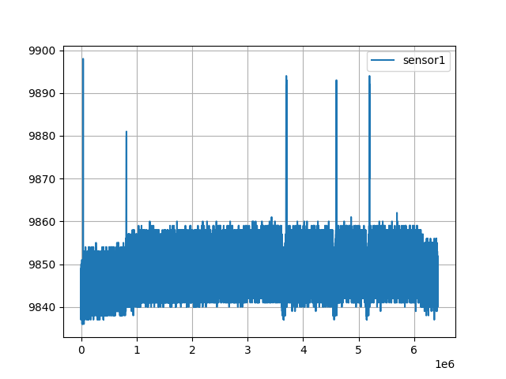
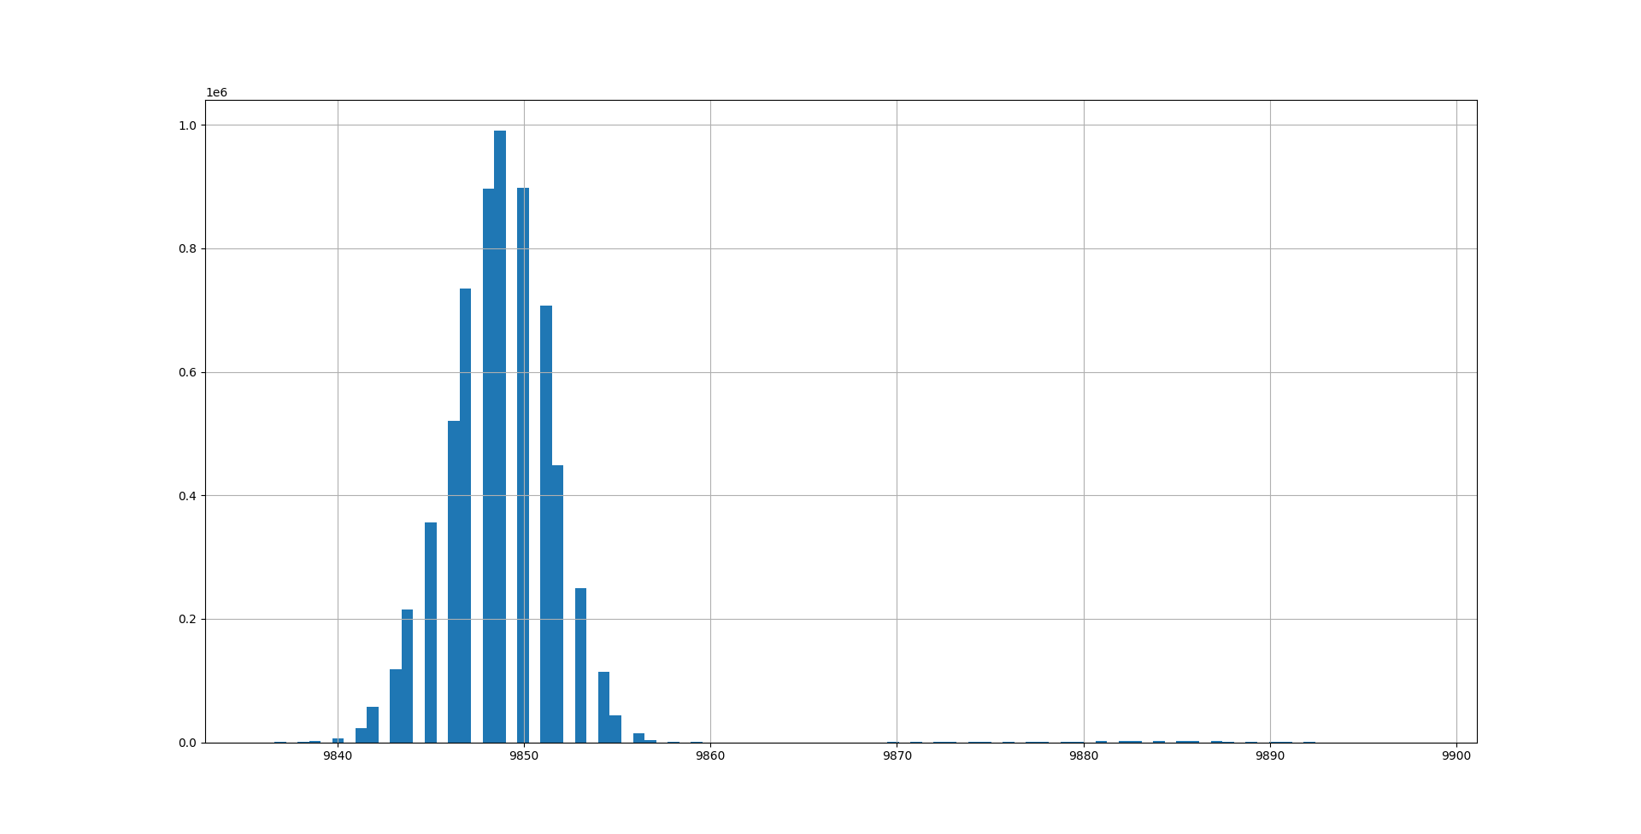
Data Visualization
Sensor 1
Entropy: 3.48
Compression Ratio: 4

Slide 21
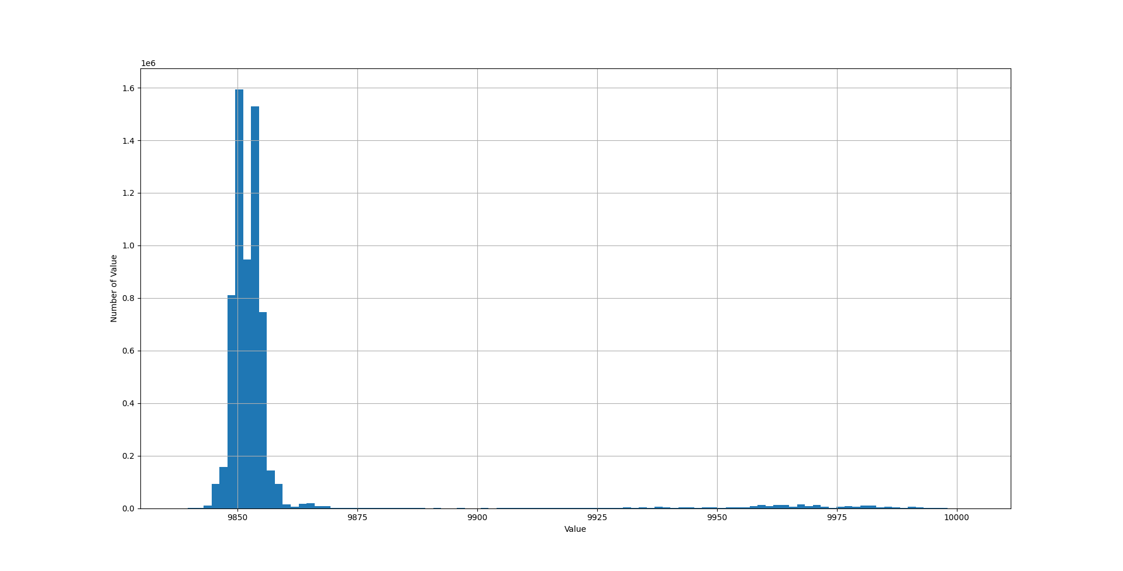
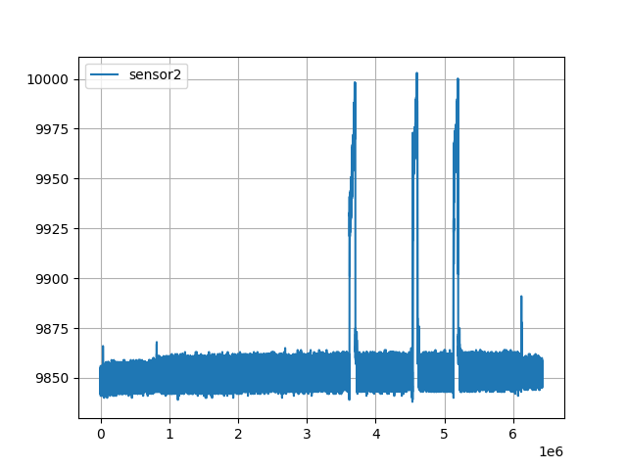
Data Visualization
Sensor 2
Entropy: 3.9
Compression Ratio: 3.8

Slide 22
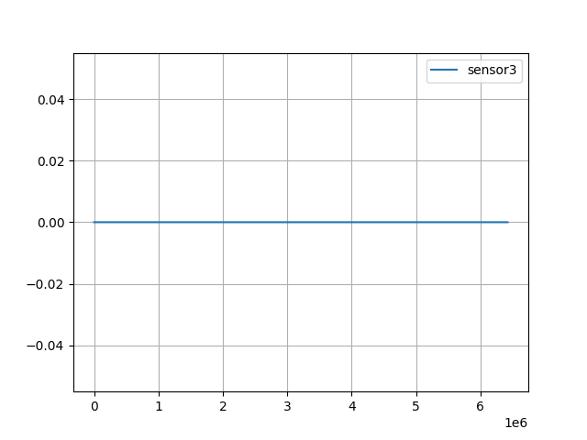
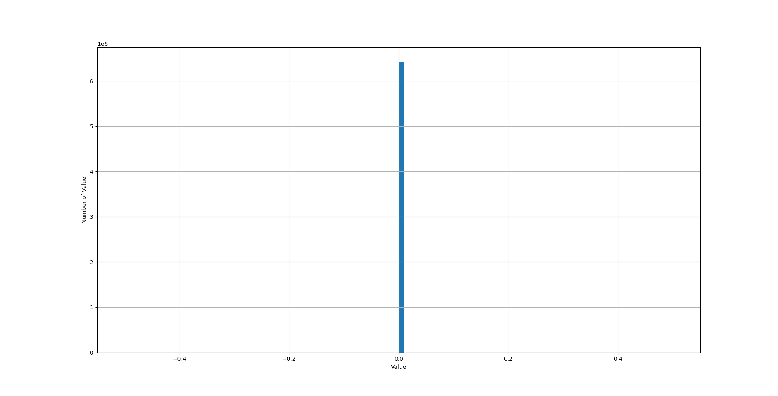
Data Visualization
Sensor 3
Entropy: 0
Compression Ratio: 1023

Slide 23
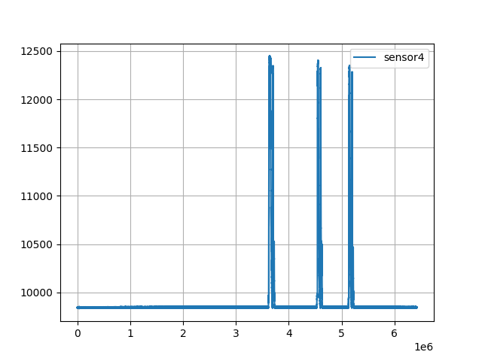
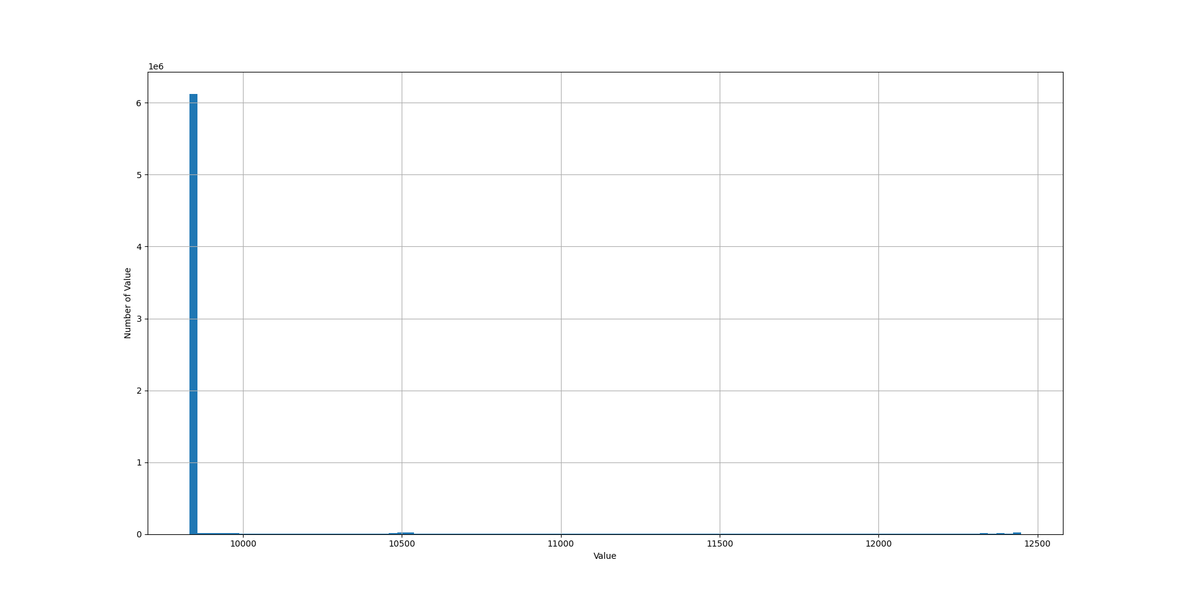
Data Visualization
Sensor 4
Entropy: 3.78
Compression Ratio: 4

Slide 24
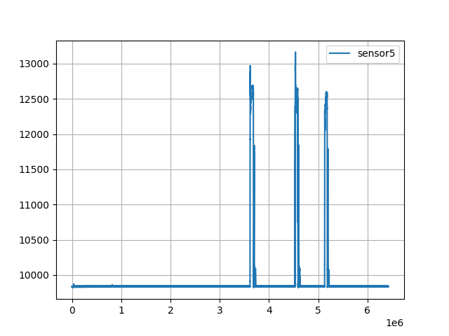
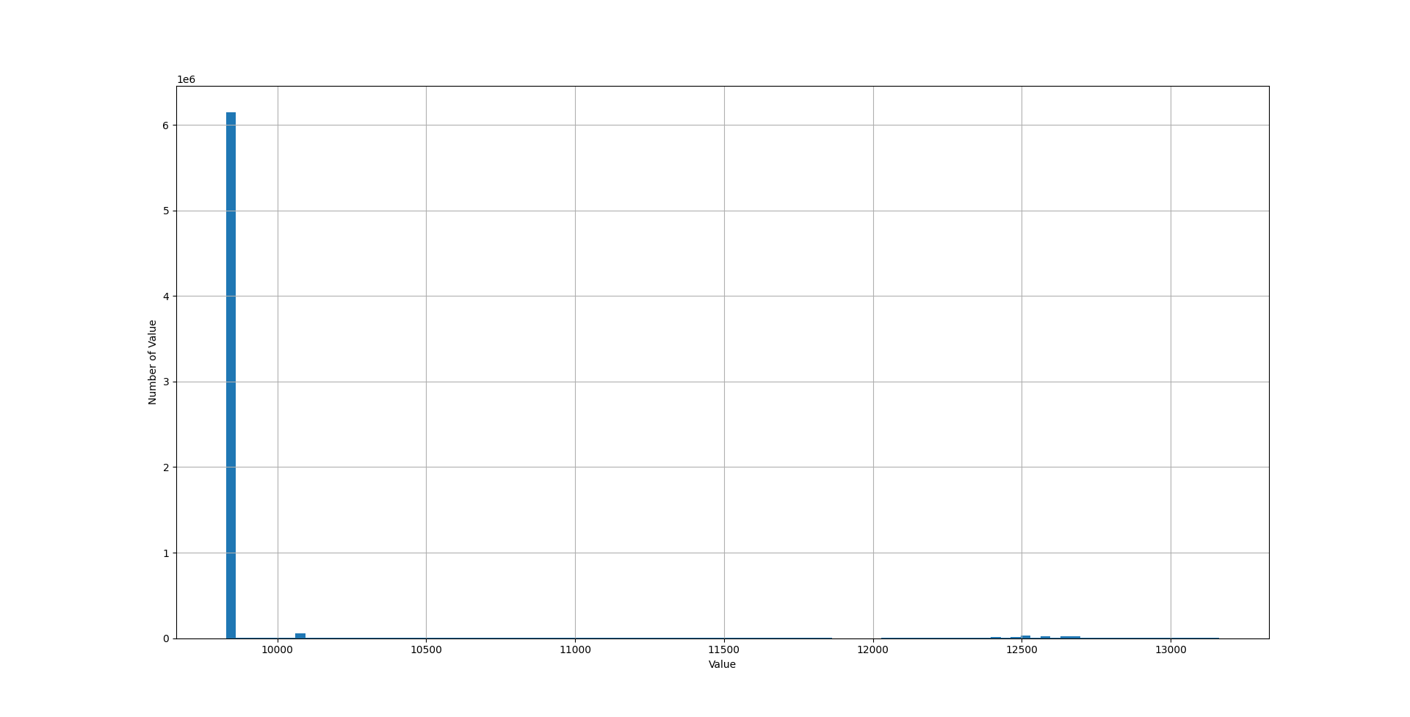
Data Visualization
Sensor 5
Entropy: 3.79
Compression Ratio: 4

Slide 25
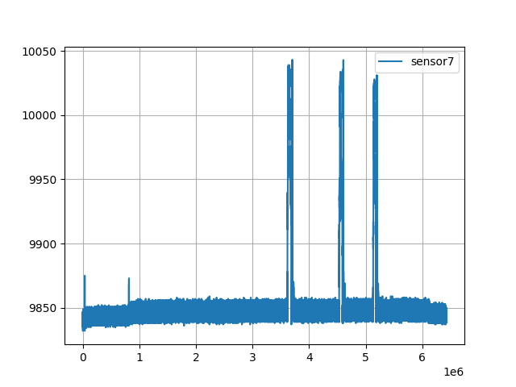
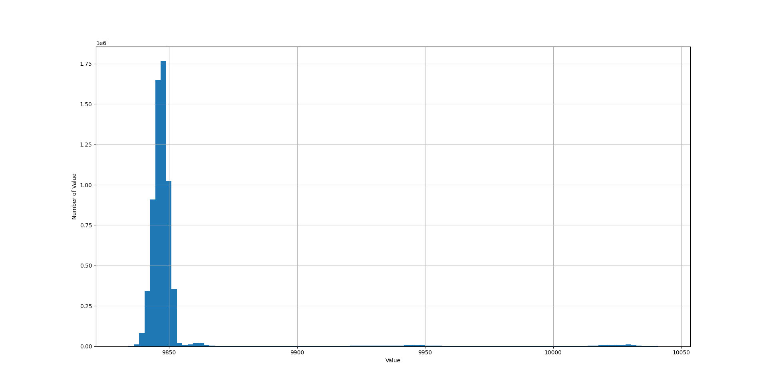
Data Visualization
Sensor 7
Entropy: 3.84
Compression Ratio: 4

Slide 26
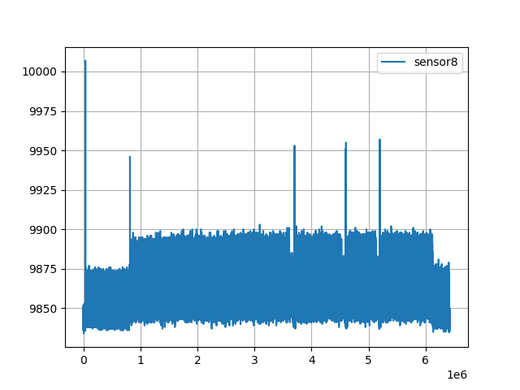
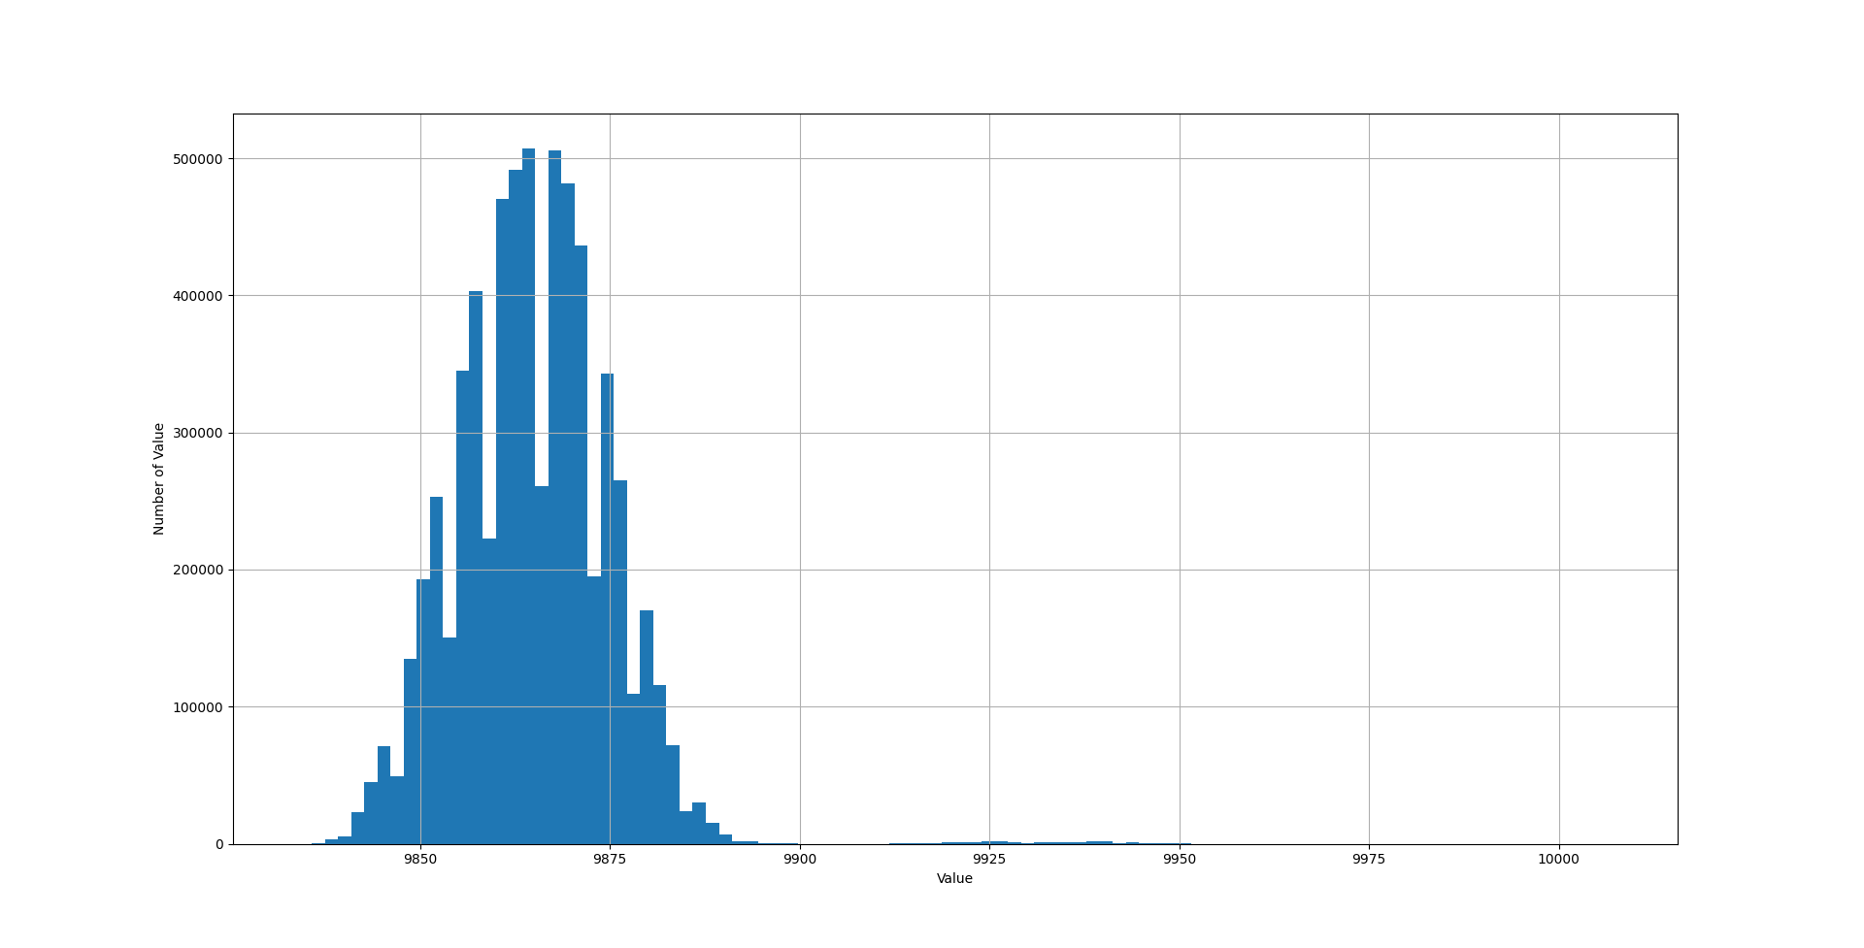
Data Visualization
Sensor 8
Entropy: 5.28
Compression Ratio: 2.8

Slide 27
Further Extension for better Compression Ratio
Custom Filtering
Smoothing filter
A smoothing Filter linearise/smoothens jitters in a curve. The smoothening level can be controlled.
Normalization
Dividing all the values by a number to reduce the variance
Kalman Filtering
Optimal Estimation algorithm to correctly estimate the incoming data. It’ll reduce variance & apply smoothening.
Trade-off
Some information will be lost.

Slide 28
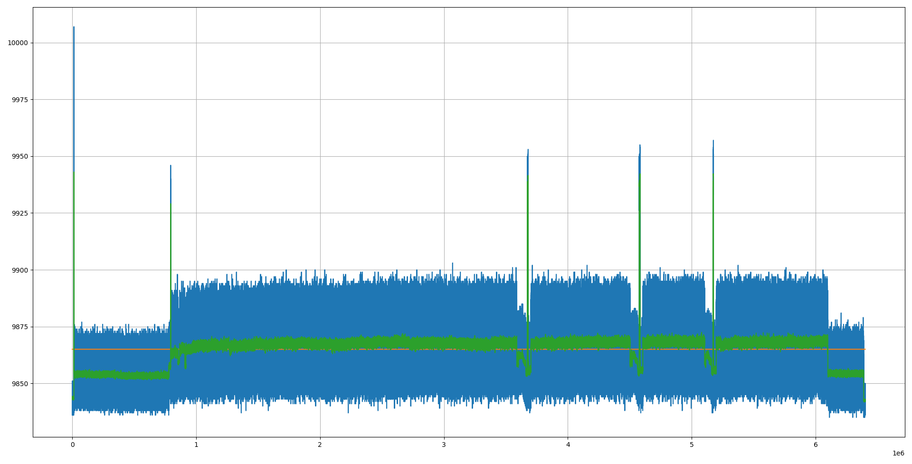
Moving Average Filter
Sensor 8 data
Compression ratio without filter: 2.8
Window Size: 64 samples
Compression Ratio: 19.32

Slide 29
Window Size: 16 samples
Compression Ratio: 8.827

Slide 30
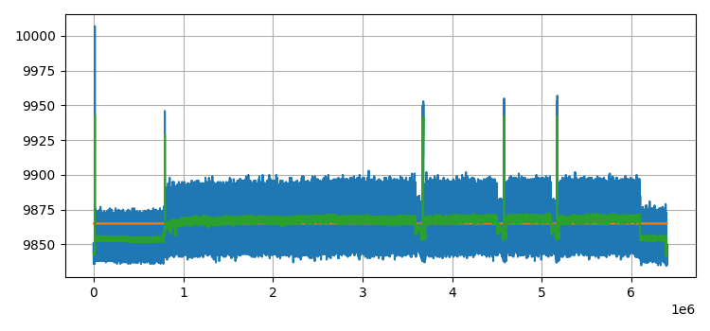
Window Size: 8 samples
Compression Ratio: 5.119

Slide 31
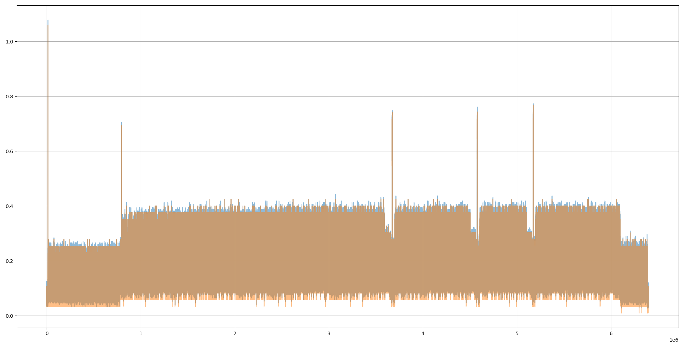
Normalizing by a Factor of 4 and Reconstructing back

Slide 32
Normalization
Sensor 8 data
Compression ratio without filter: 2.8
Normalization Factor | Compression Ratio | Mean Error (bar)
2 | 3.37 | 0.003
3 | 3.849 | 0.006
4 | 4.228 | 0.009
8 | 5.57 | 0.02

Slide 33
Combining Moving Average & Normalization
Sensor 8 data
Compression ratio without filter: 2.8
Moving Average Window | Normalization Factor | Compression Ratio | Mean Error (bar)
2 | 2 | 4.59 | 0.025
4 | 2 | 7.29 | 0.03
4 | 3 | 8.57 | 0.032
2 | 3 | 5.45 | 0.026

Slide 34
Next Deliverable
Implementation of the encoder in VHDL in Vivado suite and simulate the same in modelsim software.
Estimate the execution time of encode for various clock frequency and the corresponding resource consumption in FPGA (By implementing it in the Quartus II evaluation board)
Decide the FPGA requirement based on the above simulation and implementation

Slide 35
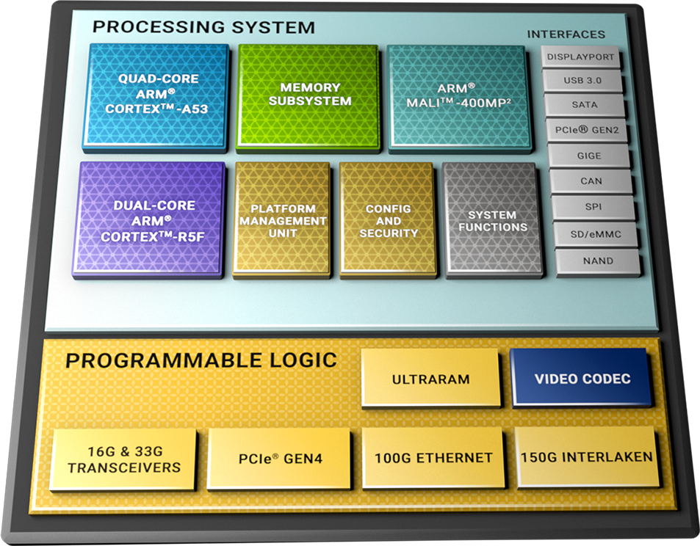
Hardware Implementation
On Vehicle(Compressor): FPGA | FPGA+CPU
Packetization Format
On Ground(Decompressor):
Standard processor(s)
Easy to implement
No Resource Constraints
Directly plot
Similar arrangement as on vehicle
https://docs.google.com/document/d/1-n-yQxugwUpotT4QNiL1lQ1ABKYw_Mv5D6WAkgy1ocI/edit

Slide 36
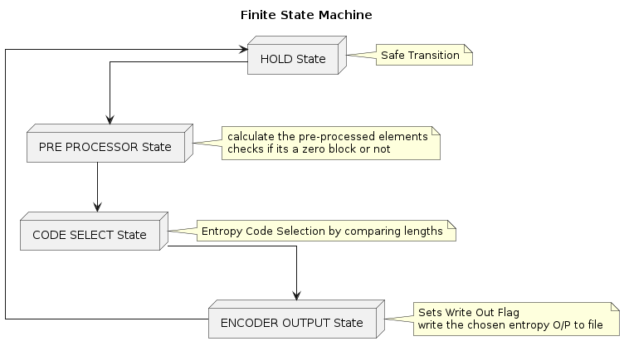
Simulation | Finite State Machine

Slide 37
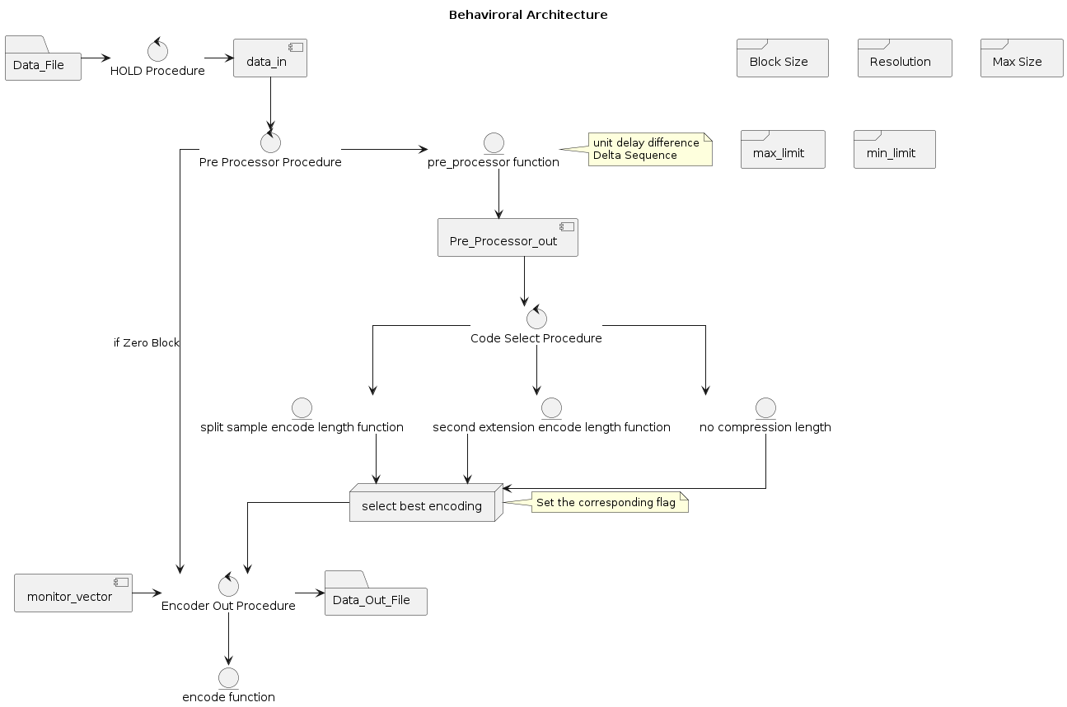
Simulation

Slide 38
Simulation | Highlights
Parameter | Measurement | Description
Timing | In terms of clock cycle | The number of cycles to complete the encoding is fixed but the clock period might change depending on the on board clock frequency.
Worst Case | 4 clock cycles | Non Zero Block
Best Case | 3 clock cycles | Zero block
Custom Filter | 1 clock cycle | If implemented inside FPGA
Storage | In terms of Register Size
Encode Vector | 2^ 14 bits = 16384 | (Max) bits
Pre processed integer array | 32 * (block size) bits

Slide 39
Discussion | Q&A
Simulation & Design Document
https://docs.google.com/document/d/1KU9jqXvNV1i9V8m-0gnjzl4fxMQQMVx49N_dhBiC9F4/edit
Prototype
https://github.com/AnubhabDebnathAgnikul/CODEC

Slide 40
List of deliverables
Deliverable | Assigner | Assignee | Deadline
Compression Algorithm implementation in VHDL | Sivasundari | Anubhab/Sivasundari | December 15 2023
Hardware selection for Decompressor in the ground |  | Sivasundari | December 1 2023
Synchronisation parameters with flight computer, Engine computer and Telemetry like Packetization format, speed and communication protocol |  | Sivasundari | December 15 2023
Optional pre processor implementation requirements |  | Sivasundari | December 15 2023

Slide 41
VHDL simulation implementation
The compression has been implemented in VHDL and simulated in vivado software
The compressed data is decompressed with the earlier python code
Behavioural model - Implementation has been done (hardware consumption has not been considered)
Idle execution time calculation for three different clk frequency (to spec the FPGA) has been done (Its always < 3 ms )

Slide 42
Next steps
Emulation of VHDL code in FPGA (Altera Cortex - IV) evaluation board
Calculate the execution time.
Check the hardware usage.
Check the communication with EC (if possible)

